Slide 1
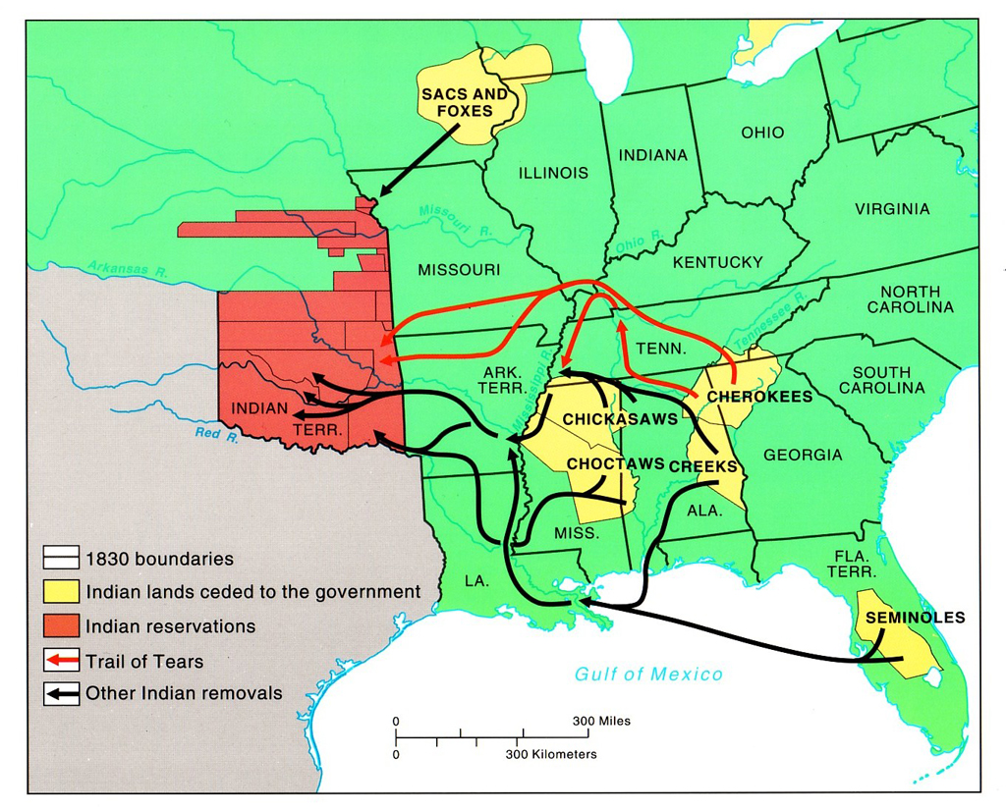
INDIAN REMOVAL

Slide 2
Video Clip: https://www.youtube.com/watch?v=T9McTuHn4gM

