Slide 1
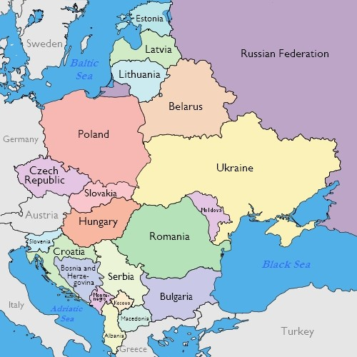
EASTERN EUROPE
Atlas pg 83
EASTERN EUROPE
Atlas pg 83

