Slide 1
5 Themes of Geography

Slide 2
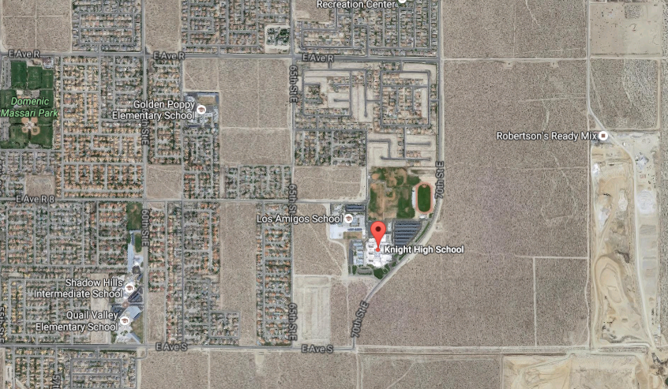
5 Basic Themes of Geography
#1 Location: Where are we?
Absolute Location
Relative Location
Provides a definite reference to locate a place. Is given in degrees of latitude and longitude (global location) or street address (local location)
Latitude: angular distance north or south from the Earth’s equator marked in degrees
Longitude: angular distance expressed in degrees east or west of the Prime Meridian, which runs through Greenwich, England
Depends upon point of reference (ex: near, far, a short drive, etc.)
Described by landmarks, time, direction or distance from one place to another
You are here

Slide 3
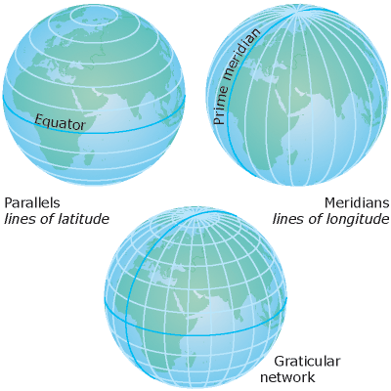

Slide 4
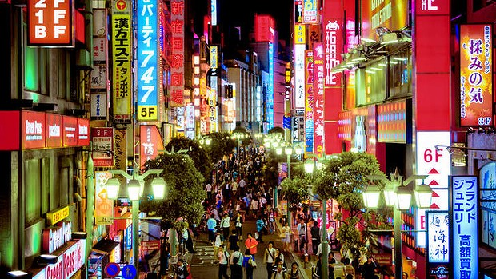
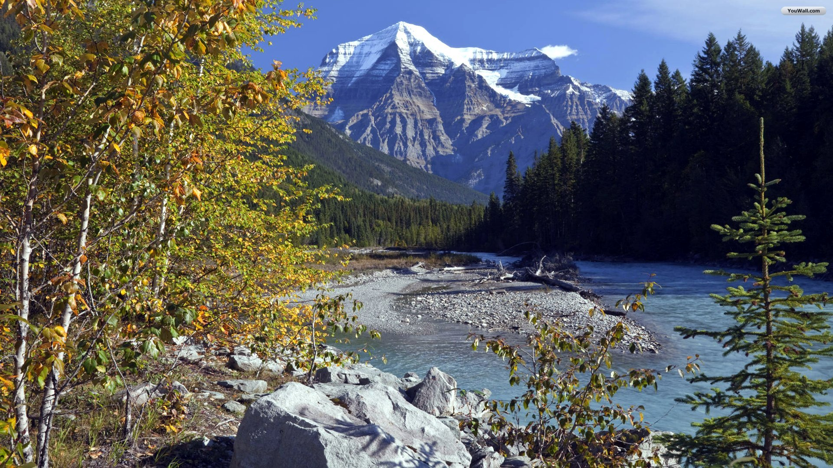
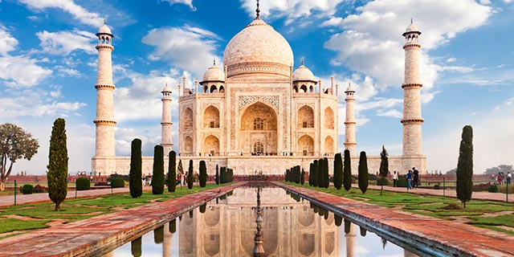
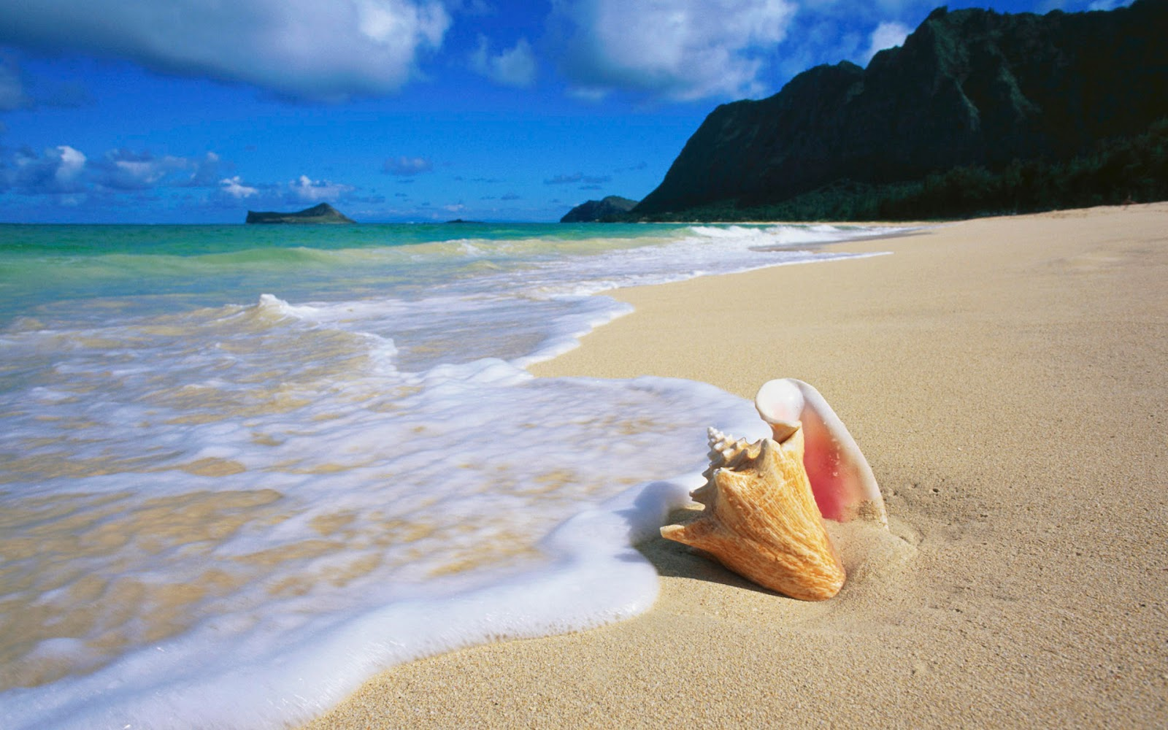
Themes Cont’d
#2 Place: the physical and cultural characteristics of an area
What is it like there? What kind of place is it? What do you think of when you imagine…?
Human characteristics:
Physical characteristics:
derived from ideas/actions of people that result in changes to the environment (bridges, buildings, roads, clothing, food habits, language, culture) – cultural landscape
Landforms (mountains, plains, etc.), bodies of water (oceans, rivers, lakes, etc.), ecosystems (soil, plants, animals, climate)

Slide 5
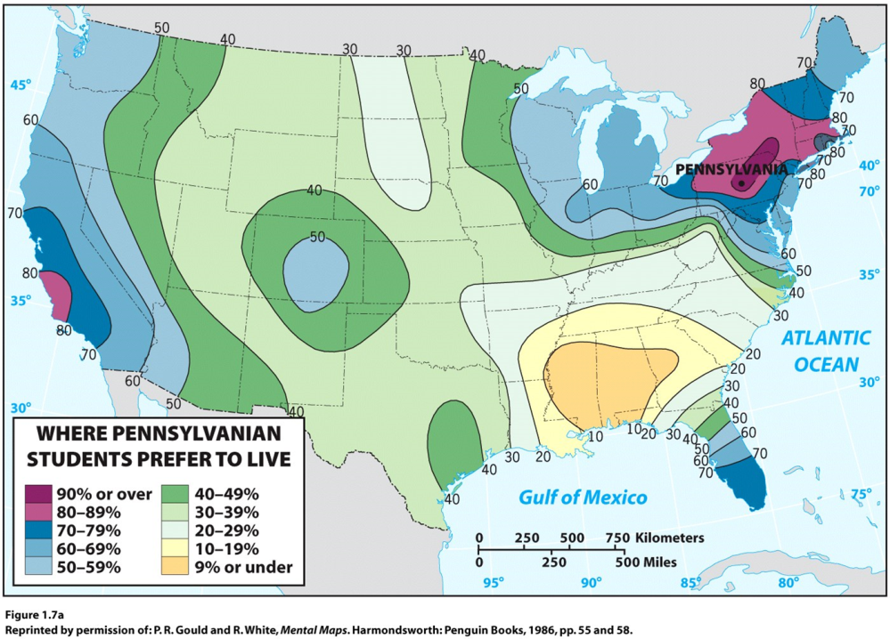
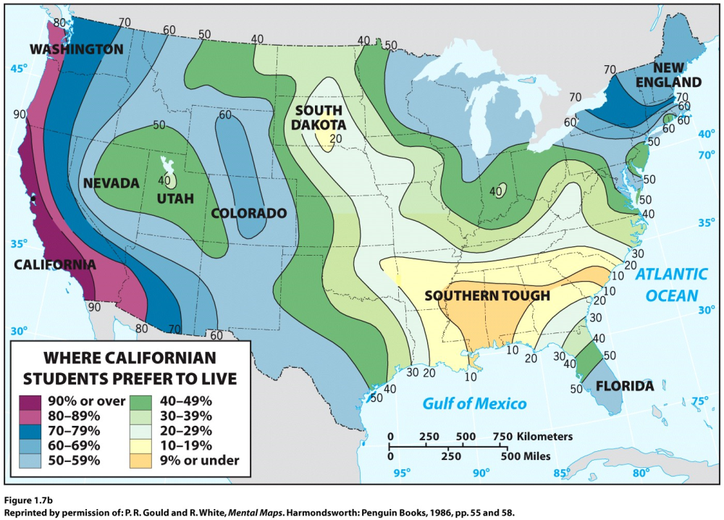
Place cont’d
People develop a sense of place by infusing a place with meaning and emotion.
We also develop perceptions of places where we have never been through books, movies, stories, and pictures.

Slide 6
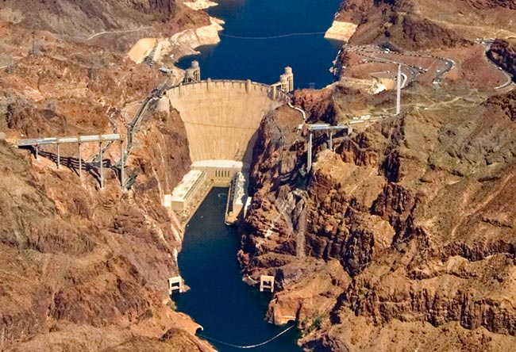
Themes Cont’d
#3 Human-Environment Interaction: the relationship between people and the land
How do people interact with and change their environment?
We depend on the environment
Ex: rivers = water, transportation
We adapt to the environment
Ex: wear shorts in summer, coats in winter
We modify the environment
Ex: heating and cooling buildings for comfort
Construction of Hoover Dam on Colorado River

Slide 7
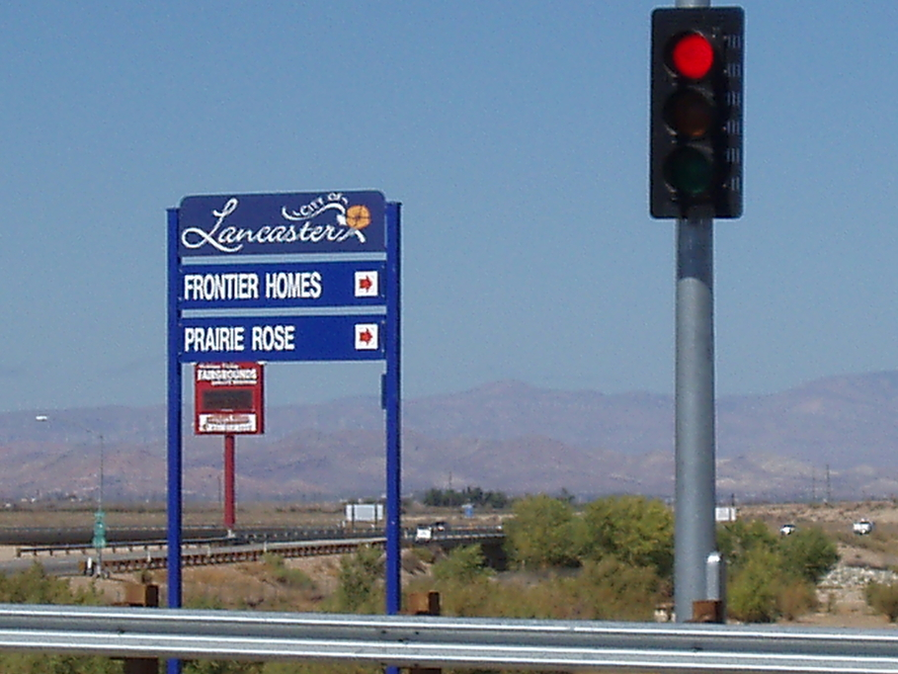
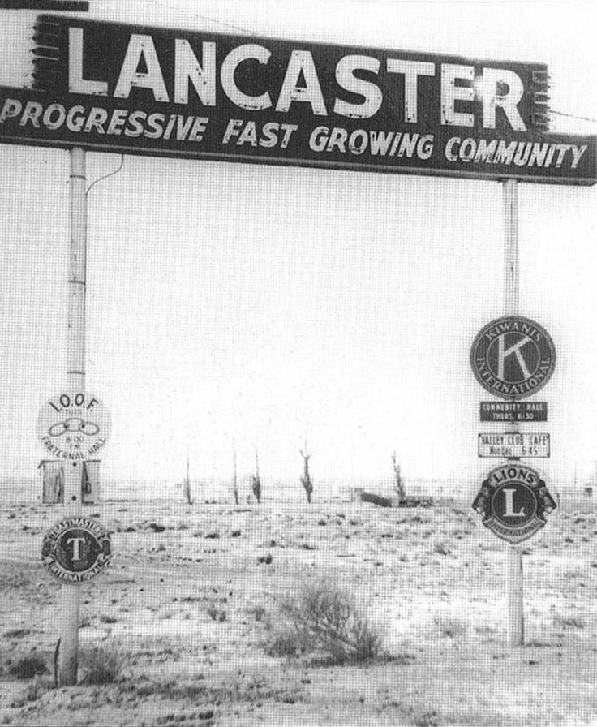
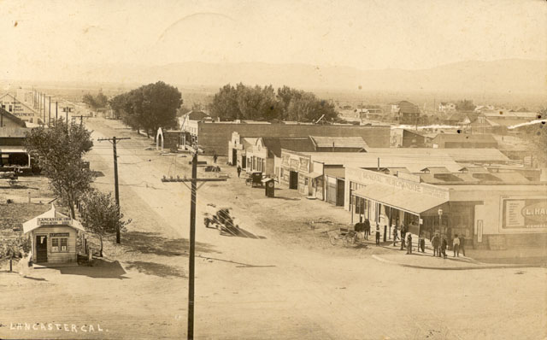
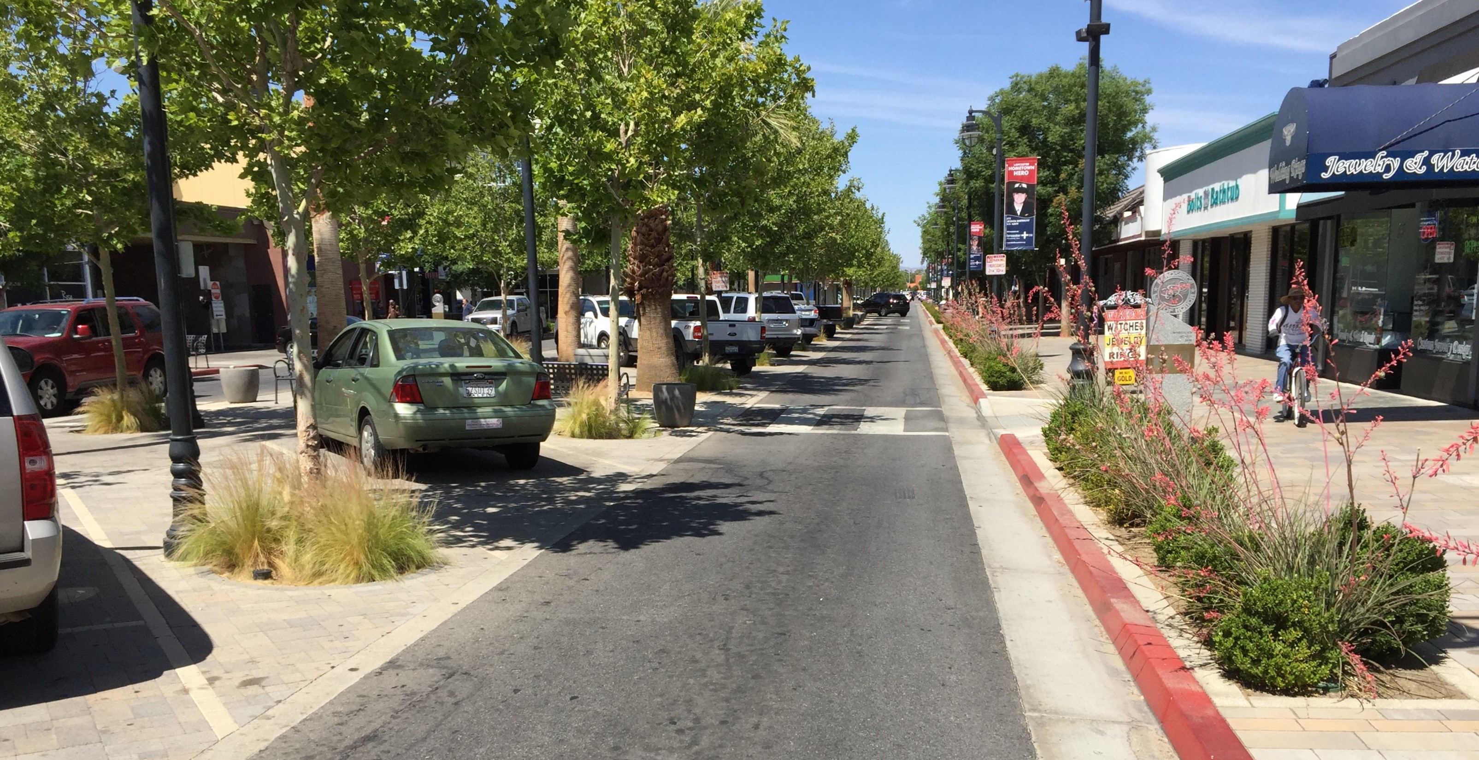

Slide 8
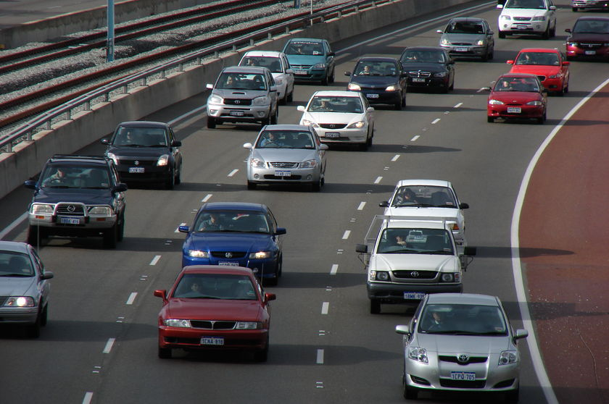
Themes Cont’d
#4 Movement: the effort of people to overcome the limits of place
Movement of people
Cars, trucks, trains, planes
Movement of products
Cars, trucks, trains, planes
Movement of information/ideas
Phones, internet, social media, radio, magazines, TV, mail

Slide 9
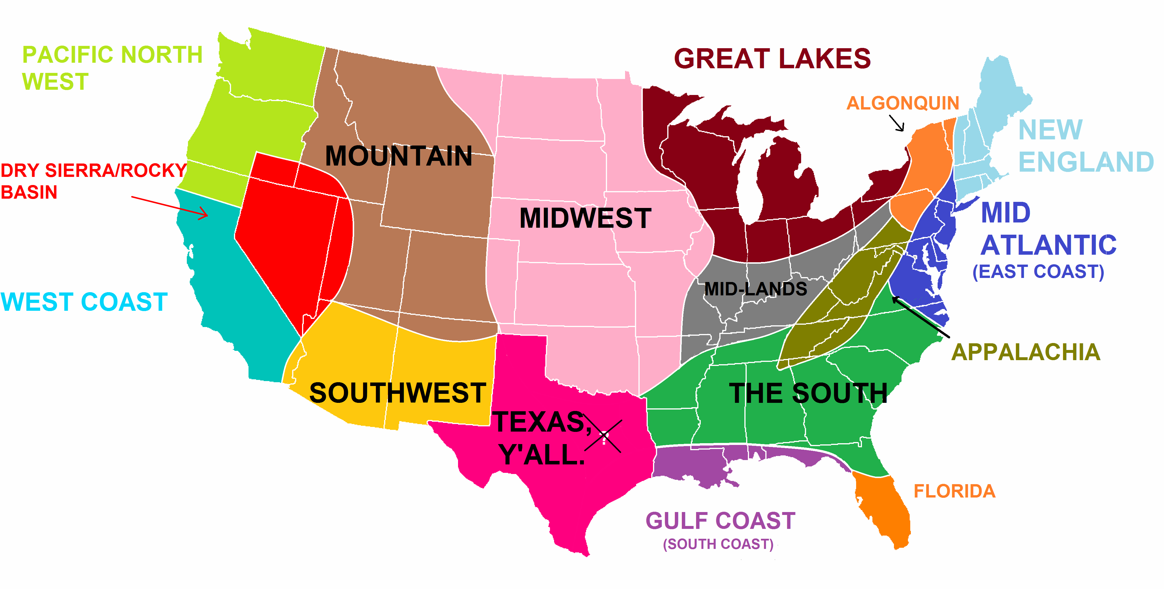
#5 Region: any area based on one characteristic (larger than place – ex: the South)

Slide 10
Geographers who practice fieldwork keep their eyes open to the world around them and through practice become adept at reading cultural landscapes. Take a walk around your campus or town and try reading the cultural landscape. Choose one thing in the landscape and ask yourself, “What is that and why is it there?” How might the existence of that thing influence the future development of the neighborhood?

