Slide 1
Pop Culture vs Folk Culture

Slide 2
Pop Philosophy
High culture: used to describe the pattern of cultural experiences and attitudes that are associated with more elite segments of society
Low culture: used to refer to experience, objects, or attitudes that are associated with average people
Popular culture: refers to the pattern of cultural experiences and attitudes in mainstream society, which cuts across different divisions within a society
Notes:
Lots of differences between societies and within a culture
Sometimes difference between cultures aren’t as big as those inside cultures
Highbrow vs lowbrow (snob vs slob)
Opera or death metal?
Polo games or football games?
Walt Whitman or Us Weekly?
Changes over time: Shakespeare – lowbrow in its day, but highbrow today

Slide 3
Subculture
Subcultures: smaller cultural groups within a larger culture
Members of subcultures are part of the larger culture, but also share a wonderfully specific identity within a smaller group
Knight High School
Band
Theatre
Athletes
Anime
Countercultures: type of subculture that rejects the larger culture’s norms and values, actively defy larger society
1960s Hippies

Slide 4
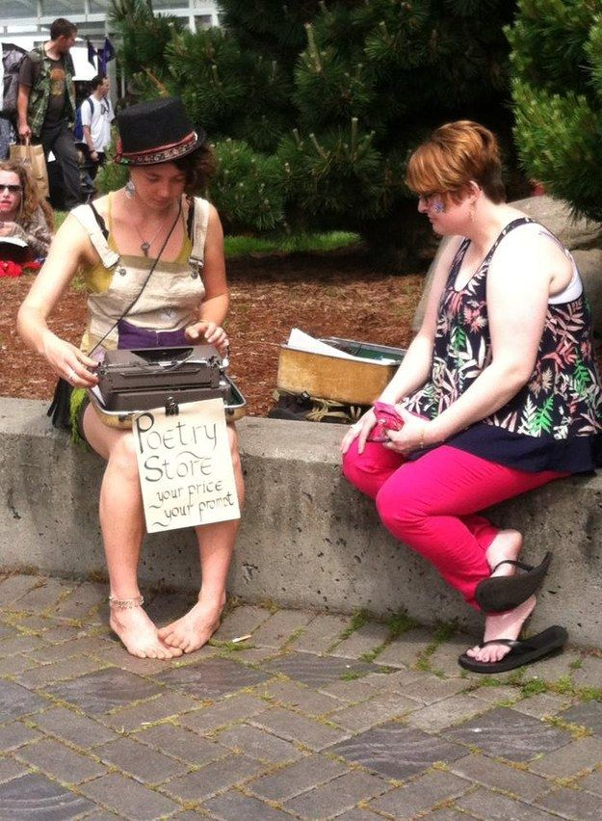
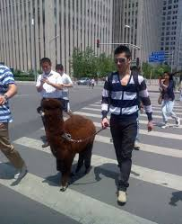
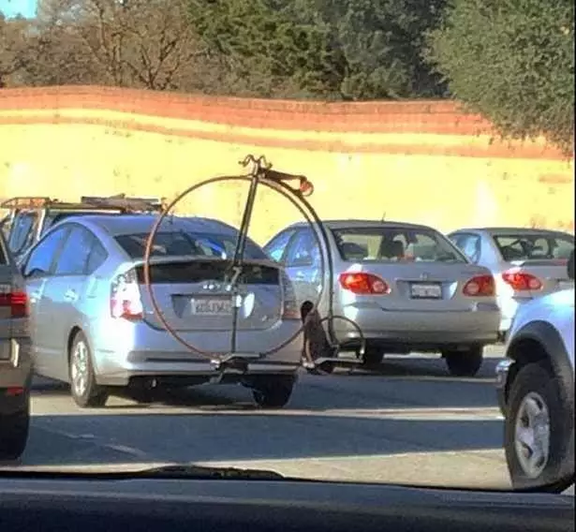
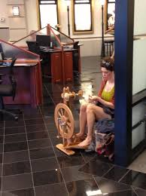
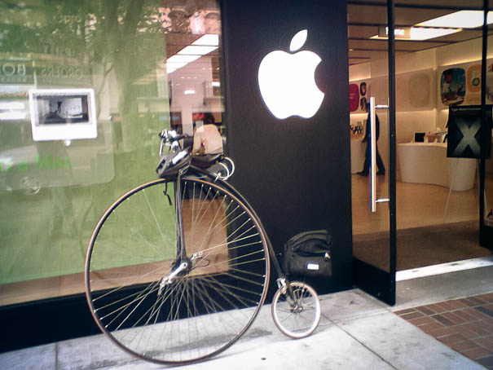
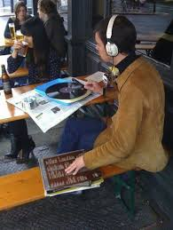
Hipsters

Slide 5
Subculture
Subcultures: smaller cultural groups within a larger culture
Members of subcultures are part of the larger culture, but also share a wonderfully specific identity within a smaller group
Band
Theatre
Athletes
Bronies
Countercultures: type of subculture that rejects the larger culture’s norms and values, actively defy larger society
1960s Hippies

Slide 6
Following the Folk
Folk culture: made by and for relatively small and isolated groups of people
Rooted in tradition, changes more slowly than pop culture
Common threads
Strong sense of place, rooted in geographic origins of culture
Focused on the community as a whole, rather than the individual
Transfer traditions and practices orally through generations
Risk of dying out entirely if new generations decline to pass on traditions

Slide 7
Amish
Example of U.S. folk culture
Christians who believe in living and dressing simply
Mostly in Pennsylvania and Ohio
Strict set of traditions
Must be baptized in order to remain member of the community
Prohibited from using electricity, serving in the military, participating in government programs
Travel by horse and buggy
Folk culture historically a source of inspiration for pop culture

Slide 8
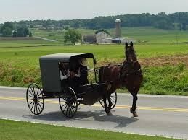
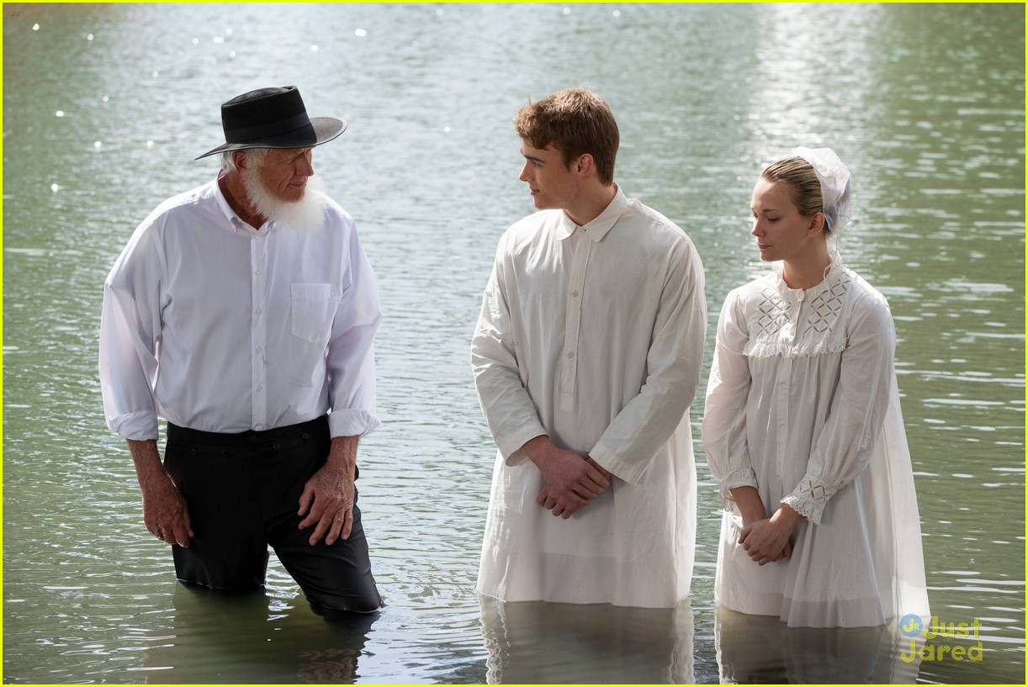
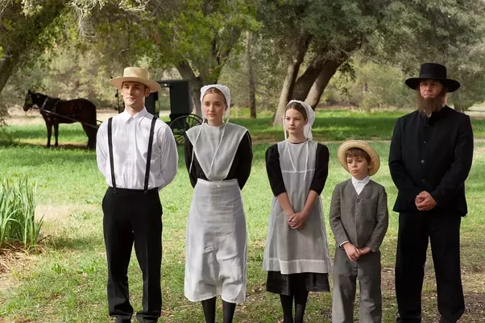
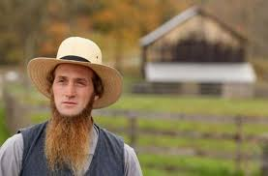
Amish

Slide 9
