Slide 1
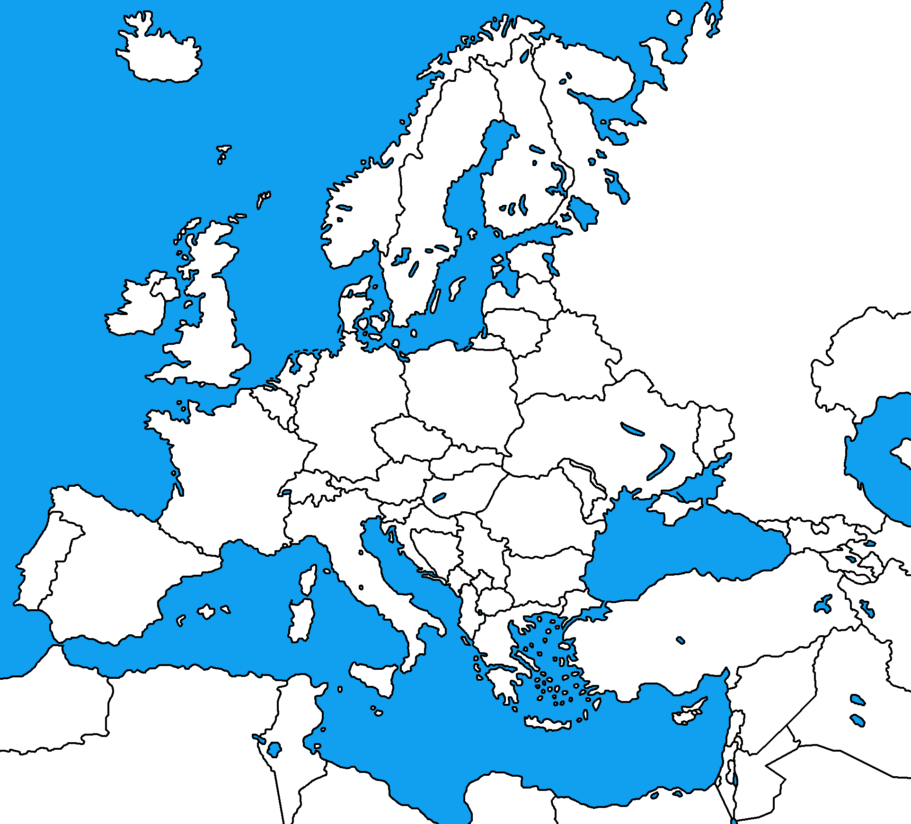
WESTERN EUROPE
Map Quiz
15
18
16
17
12
14
13
11
8
10
9
3
6
5
4
1
2
7

